Slide 1
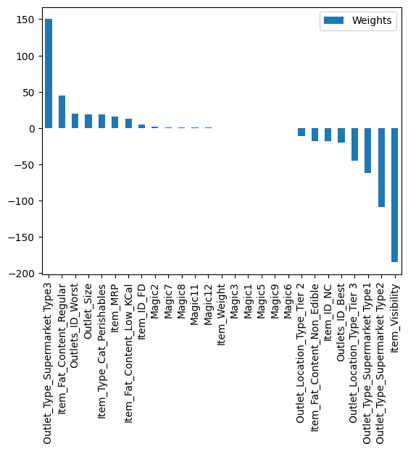




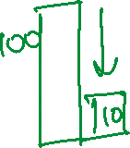





Slide 2
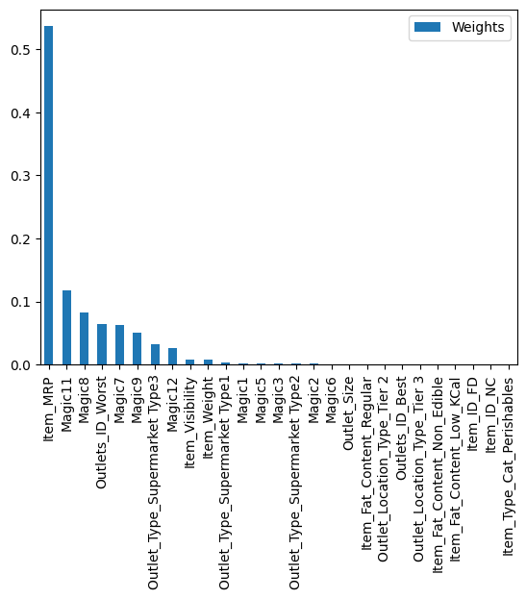

Slide 3



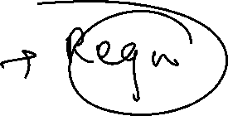
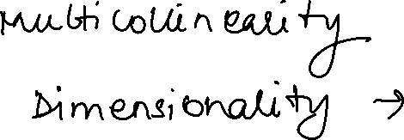





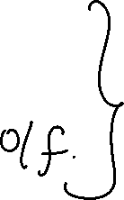




Slide 4




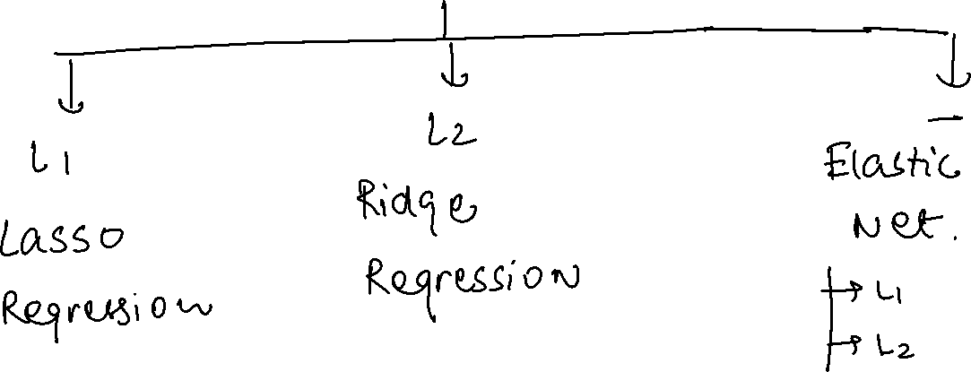


Slide 5



















Slide 6



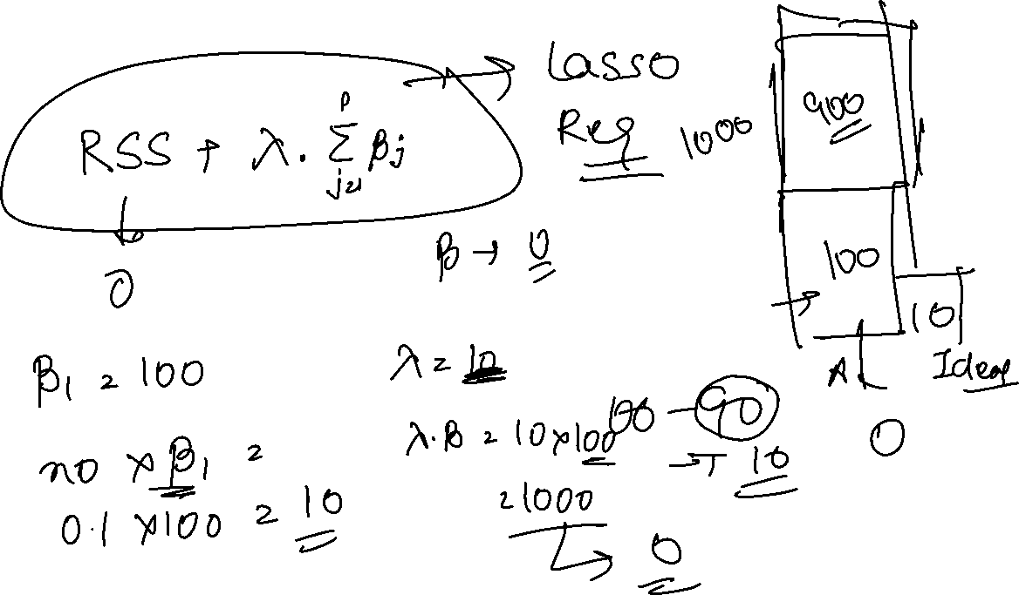





Slide 7



















Slide 8







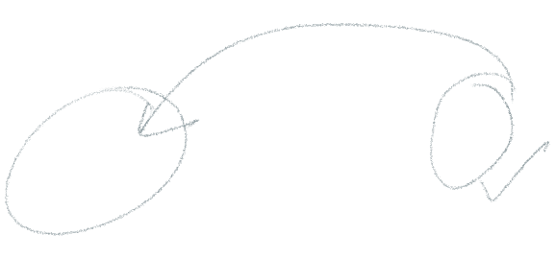















Slide 9





























Slide 10
Model Comparison
Highlights
Ridge cannot reduce the coefficients to Zero.
Lasso can reduce and thus used for Feature Selection
Elastic Net is used when the features are highly correlated.
Shrinkage makes the model simpler, reduces overfitting by introducing bias and improves generalization

Slide 11

Alpha = 0.1

Slide 12
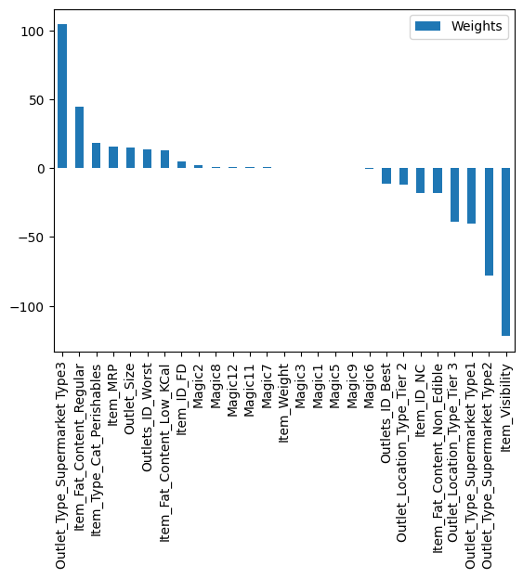
Alpha = 0.1
Alpha = 10

Slide 13
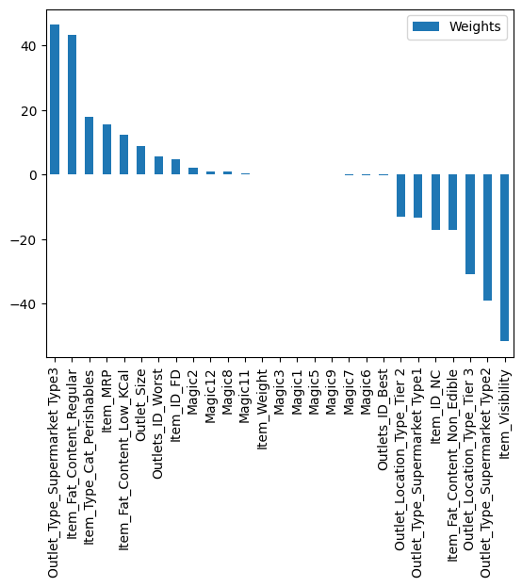

Slide 14
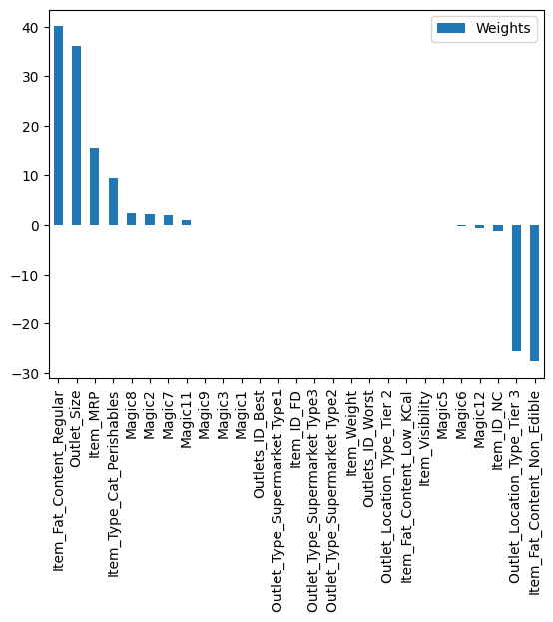
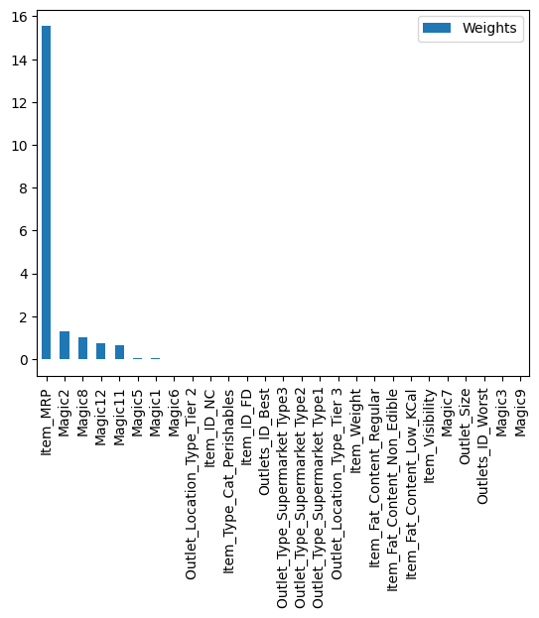
Lasso Regression
Alpha = 1
Alpha = 10

Slide 15
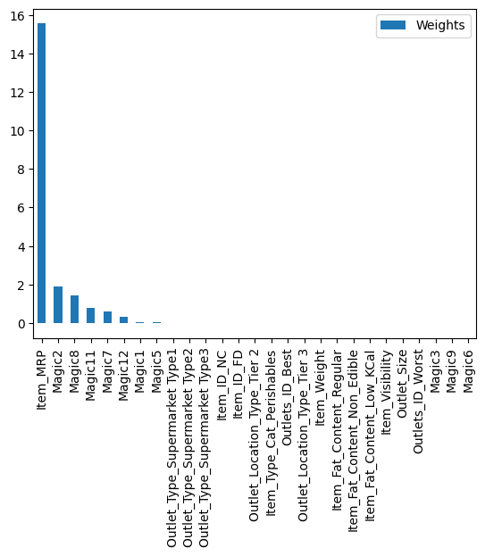
Lasso Regression
Alpha = 25 after Parameter Tuning

Slide 16
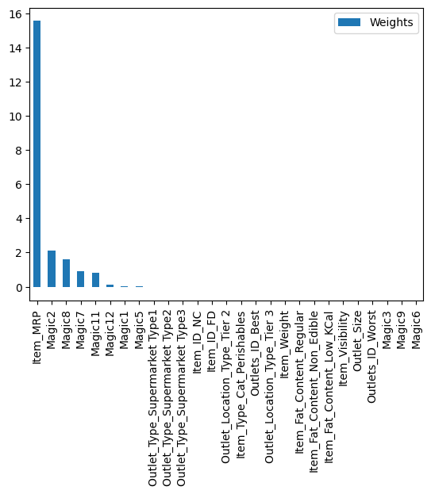
Alpha = 1
L1_ratio = 1
Alpha = 10
L1_ratio = 1

Slide 17
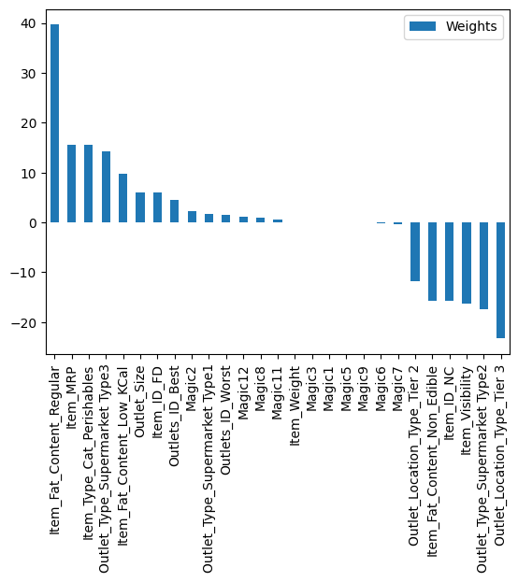
Output after Randomized Search CV where alpha = 200
Model name: Ridge Regression

Slide 18



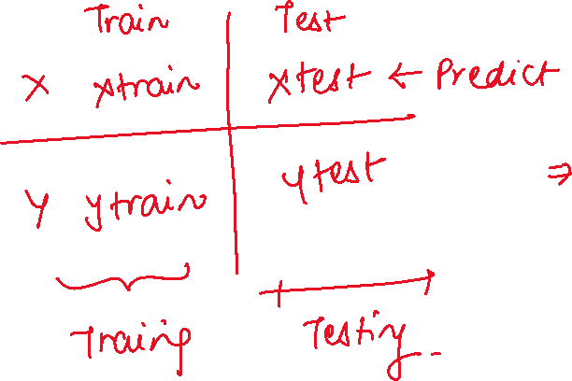








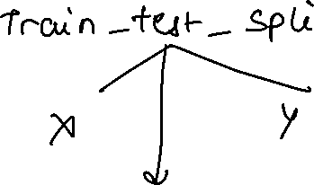




Slide 19
















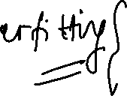










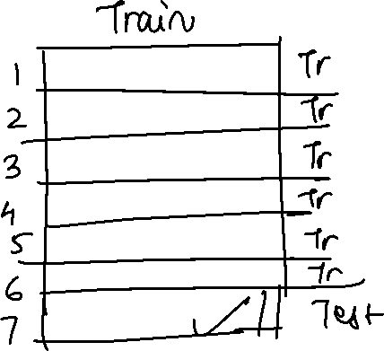

Slide 20








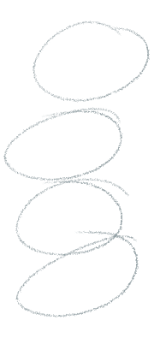















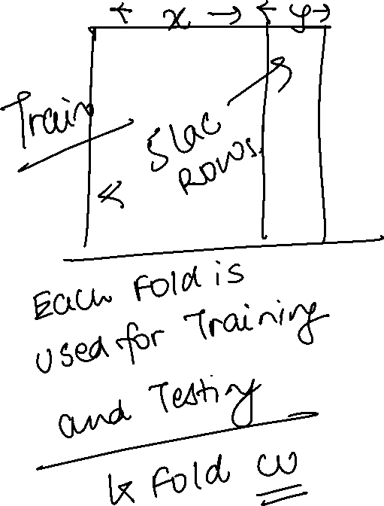

Slide 21

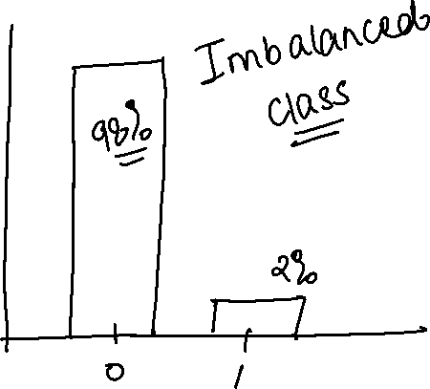





Slide 22

